Slide 1


Public Health Insurance
ACCESS TO HEALTH CARE SYSTEM IN POLAND FOR FOREIGNERS

Slide 2
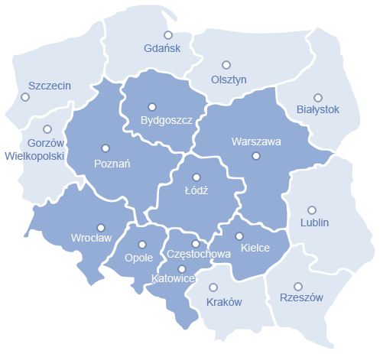


Slide 3
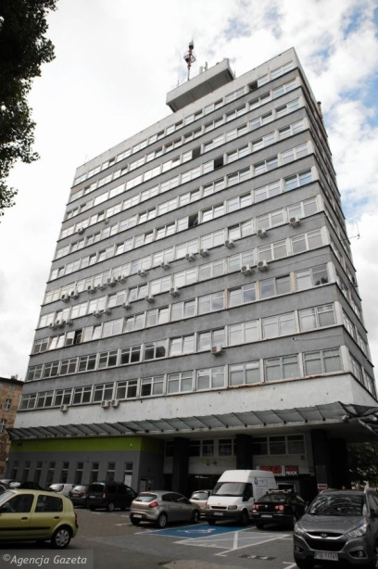
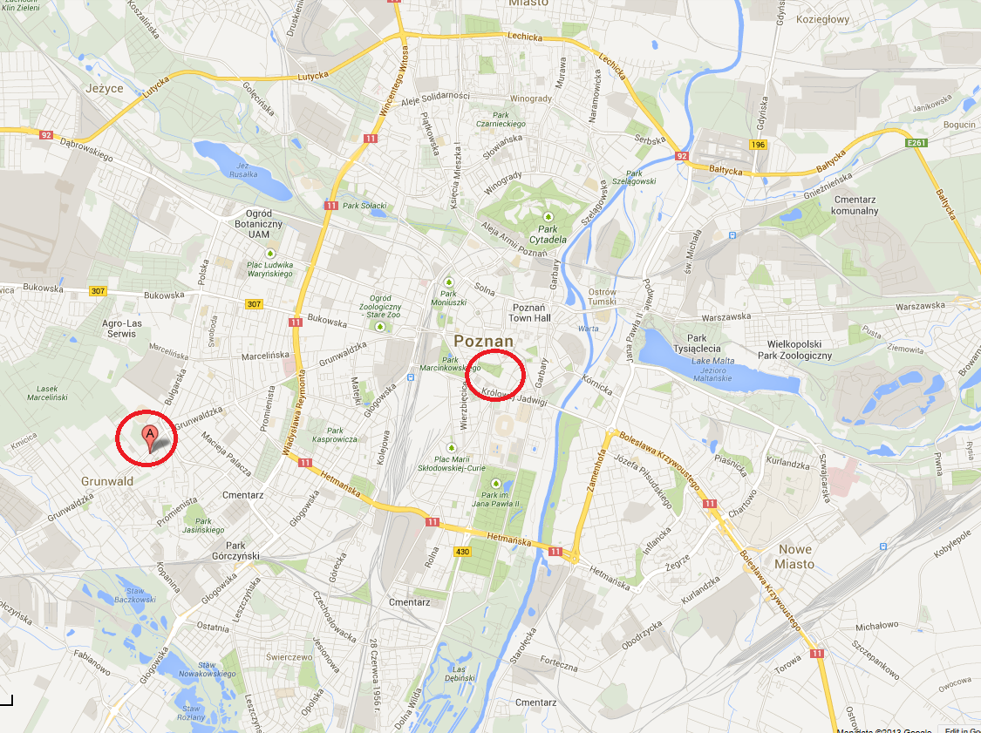
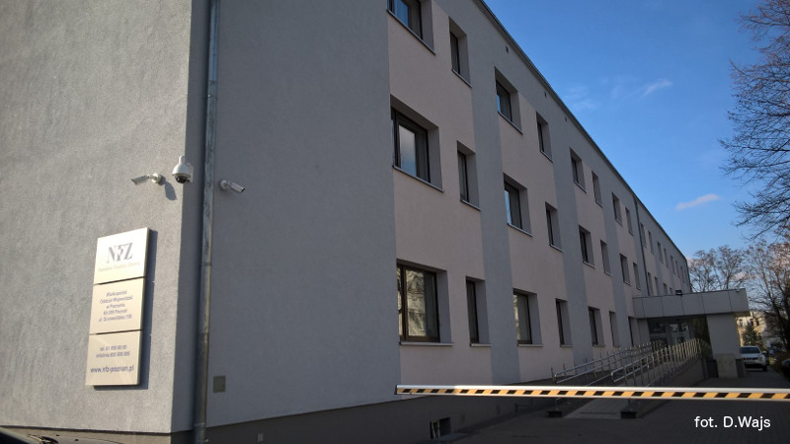
National Health Fund: offices in Poznań
PIEKARY STREET 14/15
GRUNWALDZKA STREET 158

Slide 4

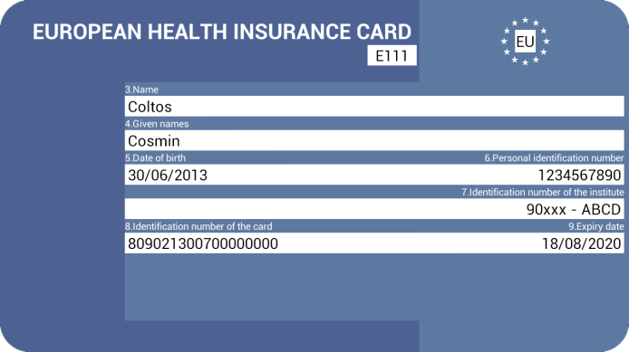

How to get health insurance?
Source: www.sxc.hu

Slide 5


STEP 1
Signing an agreement with the NFZ
Required documents:
  certificate issued by
  the Polish university
  passport or residence card
  61-823 Poznań, Piekary Street 14/15
  61/ 655 44 44
Source: www.sxc.hu

Slide 6
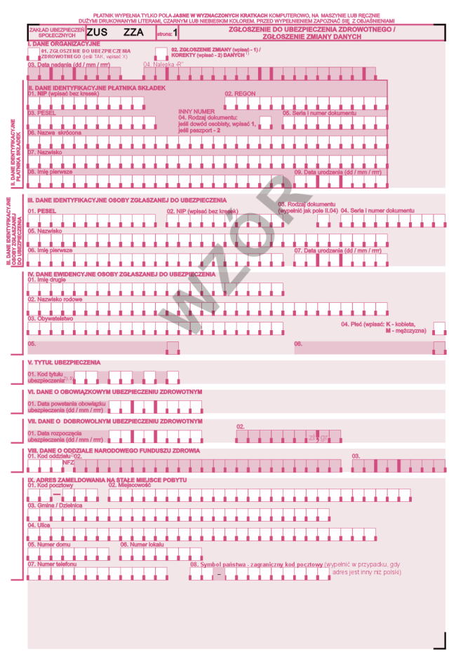

STEP 2
Registration of the agreement with ZUS
(Zakład Ubezpieczeń Społecznych = Social Insurance Institution)
submission of ZUS ZZA form within 7 days
www.zus.pl
Poznań, Dąbrowskiego Street 12
61/ 841 60 00

Slide 7

STEP 3
Monthly payment of contributions
Fee: 55,80 PLN / per month
payment on account of
the Social Insurance Institution
not later than on the 15th day
of each month for preceding month
Source: www.sxc.hu

Slide 8

STEP 4
Termination of agreement
If you:
finish your studies
finish your stay in Poland
start a job etc.
Source: www.sxc.hu
1. inform NFZ and declare termination of the agreement
2. Fill in ZWUA form and send it to the
Social Insurance Institution

Slide 9





Why NFZ?
The insured have access to:
primary health care,
specialized health care,
hospital treatment,
dental care,
drug refund,
… and much more!
Source: www.sxc.hu

Slide 10

Problems…?
…queues!
Source: http://www.jchendrick.ie/queue-systems/

Slide 11
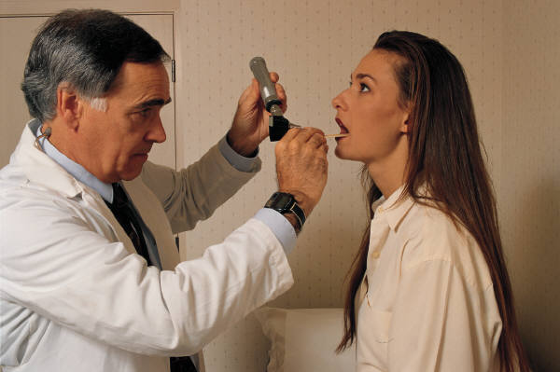

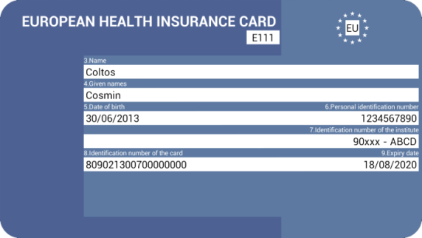
At the doctor’s:
Source: www.sxc.hu
Take your proof of health insurance:
  the European Health Insurance Card (for UE citizens)
  or copy of the agreement with the
  last month payment sheet

Slide 12

PESEL: Citizen Registration Number
if you have it – use it!
if you don’t have it –
use passport or
residence card number
instead
Source: www.sxc.hu
Department of Civil Affairs,
Poznań, Libelta Street 16/20

Slide 13



If you have PESEL number
you can prove that you’re insured
via an electronic system called
NOT INSURED
INSURED

Slide 14


Primary and specialised Health Care
choose your own General Practitioner
(Family Doctor)
Primary health care: Mon. – Fri.,
8 a.m. – 6 p.m.
after 6 p.m., on weekends and holidays: 24-hour care provided by special units
referral for specialised health care
without referral: gynecologist, dentist, oncologist and psychiatrist
Source: www.sxc.hu

Slide 15
Thank you for your attention ☺
61/ 655 44 44
800 190 590
kancelaria@poznan-nfz.pl
www.nfz-poznan.pl

